Slide 1
CAPSTONE PROJECT
DATA SCIENCE PROJECT
Presented By:
Bhavana K A- Chemical Engineering

Slide 2
OUTLINE
Problem Statement
Proposed System/Solution
System Development Approach
Algorithm & Deployment
Result
Conclusion
Future Scope
References

Slide 3
PROBLEM STATEMENT
Python Program for Library Management System

Slide 4
PROPOSED SOLUTION
To develop a Python program for a library management system, you'll need to design and implement a system that handles various aspects such as library schedules, book availability, user authentication,borrowal details, and more. Below are proposed solutions covering key functionalities and considerations for building a library management system program in Python:
1.⁠ ⁠Object-Oriented Design (OOD): Use classes and objects to model entities like Book, Availability, User, and Due Date. This facilitates a structured approach to representing library system components.
2.⁠ ⁠User Authentication and Management: Implement user authentication functionalities to allow users to create accounts, log in, and manage their profiles.

Slide 5
3.⁠ ⁠Book Management Solution: Manage borrowal schedules, book availability, and unavailable books within the management system.
4.⁠ ⁠Booking Transactions: Implement logic to handle booking transactions, including book Managements and token issuance.
5.⁠ ⁠Data Persistence and Storage: Implement data storage using file handling or databases (e.g., SQLite, PostgreSQL) to persist schedules, user information, and booking records.

Slide 6
SYSTEM APPROACH
1. User Interface:
Frontend Interface: Users interact with the system through a graphical user interface (GUI) or command-line interface (CLI).
Input Validation: Validate user inputs to ensure correctness and prevent invalid data entry.
2. Data Management:
books Data:
  Maintain a database or data structure to store information about books, including book number, name, available seats, departure time, and possibly other attributes like class, fare, etc.
  Store this data in a format that allows for efficient retrieval and modification.
Bookings Data:
  Store information about bookings, including booking ID, book number, number of seats booked, and passenger details (name, age, contact).
  Each booking should be linked to a specific book and have a unique identifier.

Slide 7
Functionalities:
Display Available books:
  Retrieve information about available books and display them to the user.
  Include details like book number, name, available seats, departure time, etc.
Book tokens:
  Allow users to book tokens for a selected book.
  Collect necessary details like book number, number of seats, passenger information.
  Update the available seats for the selected book after booking.
Cancel tokens:
  Enable users to cancel their booked tokens by providing the booking ID.
  Update the available seats for the respective book after cancellation.
View Booking Details:
  Allow users to view details of their booked tokens by providing the booking ID.
  Display booking details including book number, number of seats booked, passenger details, etc.

Slide 8
4. Business Logic:​
Validation:​
  Validate user inputs to ensure they are within acceptable ranges and formats.​
  Check for seat availability before booking.​
  Handle edge cases and error conditions gracefully.​
Concurrency Control:​
  Implement measures to handle concurrent access to the same data, preventing race conditions and ensuring data integrity.​
  Use locks or other synchronization mechanisms if necessary.
5. Security:
User Authentication:
  Implement user authentication to ensure only authorized users can access certain functionalities (e.g., booking, cancellation).
  Protect sensitive data like user passwords using encryption.
Data Privacy:
  Ensure that passenger details are stored securely and access is restricted to authorized personnel only.

Slide 9
6. Administration:​
Admin Interface:​
  Provide an interface for administrators to manage books, bookings, and user accounts.​
  Allow admins to add/remove books, modify seat availability, view booking history, etc.
7. Error Handling and Logging:
Error Handling:
  Handle errors gracefully and provide informative error messages to users.
  Log errors and exceptions for debugging and monitoring purposes.

Slide 10
ALGORITHM & DEPLOYMENT
Algorithm:
1. Initialization:
Initialize the LibraryManagementSystem class.
Initialize book data and booking data (either from a file/database or hardcoded).
2. Display Menu:
Display a menu with options: Display books, Book token, Cancel token, View Booking Details, and Exit.
3. Display books:
Iterate through the book data and display book details (book number, name, departure time, and available seats).

Slide 11
4. Book token:​
Prompt the user to enter the book number, number of seats, and passenger details.​
Check if the book exists and if there are enough available seats.​
If valid, decrement the available seats, generate a booking ID, and store booking details.​
Display a success message with the booking ID.
5. Cancel token:
Prompt the user to enter the booking ID to cancel.
Check if the booking ID exists.
If valid, increment the available seats, remove the booking from the booking data.
Display a success message.

Slide 12
6. View Booking Details:
Prompt the user to enter the booking ID.
Display the details of the booking if the ID exists.
7. Exit:
Exit the program.

Slide 13
Deployment:
1. Local Deployment:
Run Locally: Run the Python program on a local machine.
Installation: Ensure Python is installed. Execute the program in a Python IDE or command line.
Advantages: Simple setup, suitable for development and testing.
Disadvantages: Not accessible remotely, requires installation on each machine.
2. Web Application:
Web Framework: Use Python web frameworks like Flask or Django.
Deployment Platform: Deploy the web application on platforms like Heroku, AWS, or DigitalOcean.
Advantages: Accessible from any device with an internet connection, scalable, and easier maintenance.
Disadvantages: More complex setup, requires web development skills.

Slide 14
3. Cloud Deployment:
Serverless Computing: Utilize serverless platforms like AWS Lambda or Google Cloud Functions.
Containerization: Use Docker containers and deploy on container orchestration platforms like Kubernetes.
Advantages: Scalable, cost-effective, and managed infrastructure.
Disadvantages: Learning curve for setting up serverless or containerized environments.
4. Desktop Application:
GUI Framework: Use Python GUI frameworks like Tkinter, PyQt, or wxPython.
Deployment: Package the application using tools like PyInstaller or cx_Freeze.
Advantages: No need for internet connection, easy distribution.
Disadvantages: Platform-dependent, less accessible than web applications.

Slide 15
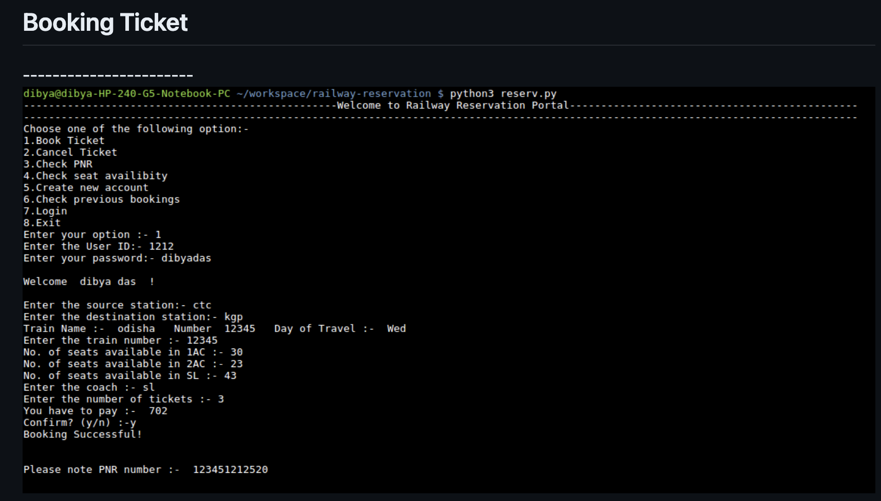
RESULT

Slide 16
CONCLUSION
The Library Management System is a crucial system that facilitates the booking and management of book tokens. In this system, we have designed a Python program to handle basic functionalities like booking tokens, canceling tokens, and viewing book details.
Key Points:
Functionality: Users can view available books, book tokens for a specific book, cancel booked tokens, and view booking details.
Data Management: book data and booking data are stored using dictionaries and lists.
User Interface: The system provides a simple menu-driven interface for users to interact with.

Slide 17
4. Error Handling: Input validation and error messages are provided to ensure smooth user experience.
5. System Design: The system is designed with clear components: user interface, data management, functionality, error handling, and control flow.
  6. Optional Features: The system can be extended with features like user authentication, admin interface, and data persistence.

Slide 18
FUTURE SCOPE
User Behavior Analysis
Personalized Recommendations
3.Collection Development
4. Predictive maintenance
5. Space utilization optimization
6. Digital Resource Management
7. Budget Optimization

Slide 19
THANK YOU

